Slide 1


The importance of word in the legal context
Pessina tommaso
961739

Slide 2
Dataset
It is the Illinois Bulk Dataset, a collection of many court decision over the years.
The two relevant filed are:
Casebody: content of the court decision
Decision date: date of resolution of the court decision
For our analysis we define three subject of interest:
narcotics
weapons
investigation

Slide 3
Steps
Data cleaning:
convert to lower case, remove special character, number and format symbol. Then remove all the stopwords and punctuation
Analysis:
Term frequency
Word similarity
Terminological trend over the years
Topic model
What is the aim?
Find a method to exploit any correlation/correspondence between word in the legal context.

Slide 4
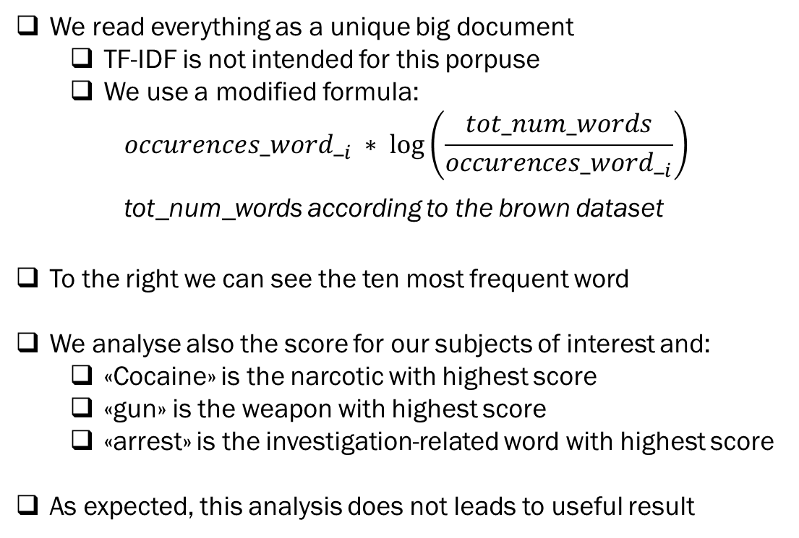
Term frequency
We read everything as a unique big document
TF-IDF is not intended for this porpuse
We use a modified formula:
$${occurences_word_}_{i} ∗ \log\left(\frac{tot_num_words}{{occurences_word_}_{i}}\right)$$
tot_num_words according to the brown dataset
To the right we can see the ten most frequent word
We analyse also the score for our subjects of interest and:
«Cocaine» is the narcotic with highest score
«gun» is the weapon with highest score
«arrest» is the investigation-related word with highest score
As expected, this analysis does not leads to useful result
Score | Word
427139.55 | whether
427016.78 | error
427009.97 | illinois
426959.04 | appeal
426918.08 | motion
426793.69 | could
426644.58 | first
426496.84 | counsel
426434.15 | question
426334.80 | appellant

Slide 5
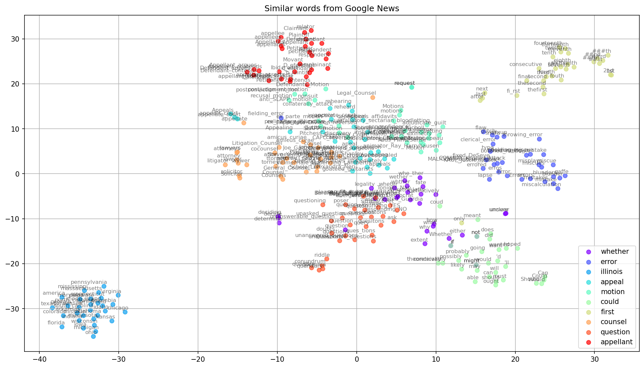
Word similarity
We use the Google news pre-trained word embedding model
Key results:
«Illinois» is similar to other states name
Similar word are:
«appeal» and «motion»
«counsel» and «appellant»
«appellant» imply «movant» and «Defedants Motion»
«lawyer» and «attorney»
«motion» and «appeal» (and motions are addressed by appeal)
Question seems to be little bit negatively correlated to the appellant
The appellant is negatively correlated to word like "could" (e.g., should, can, could)
seems that identity thief might be correlated to mafia and/or abuser

Slide 6
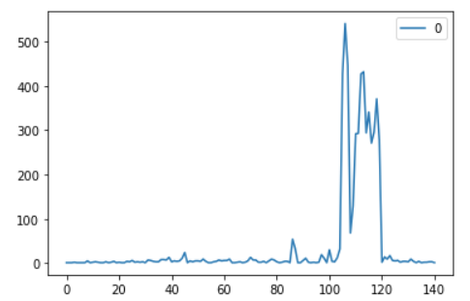
Terminological trend
In 1973 was found the Drug Enforcement Administrator, aka DEA;
In the years 1980-1985 there was a lot of activity about the DEA;
The Federal Comprehensive Drug Abuse Prevention and Control Act of 1970.. The goal of the Controlled Substances Act is to improve the manufacturing, importation and exportation, distribution, and dispensing of controlled substances (https://www.ncbi.nlm.nih.gov/pmc/articles/PMC3839489/)
Year | Count
1973 | 427
1974 | 541
1975 | 446
1980 | 427
1981 | 432
1983 | 341
1986 | 371

Slide 7
Topic model
Methods:
Latent Semantic Indexing (LSI): U_MASS coherence method -1.16028219230003
Latent Dirichlet Allocation (LDA): U_MASS method give us -1.0193124596850156
Steps:
create a dictionary representation of the documents
convert it to a BagOfWord format.
tune hyperparameters:
• 30 requested latent topics to be extracted from the training corpus;
• 2000 documents to be used in each training chunk;
• 35 passes through the corpus during training;
• 600 maximum iterations through the corpus when inferring the topic distribution of a corpus;
• we don’t evaluate model perplexity because it takes too much time;
• we choose online learning.

Slide 8
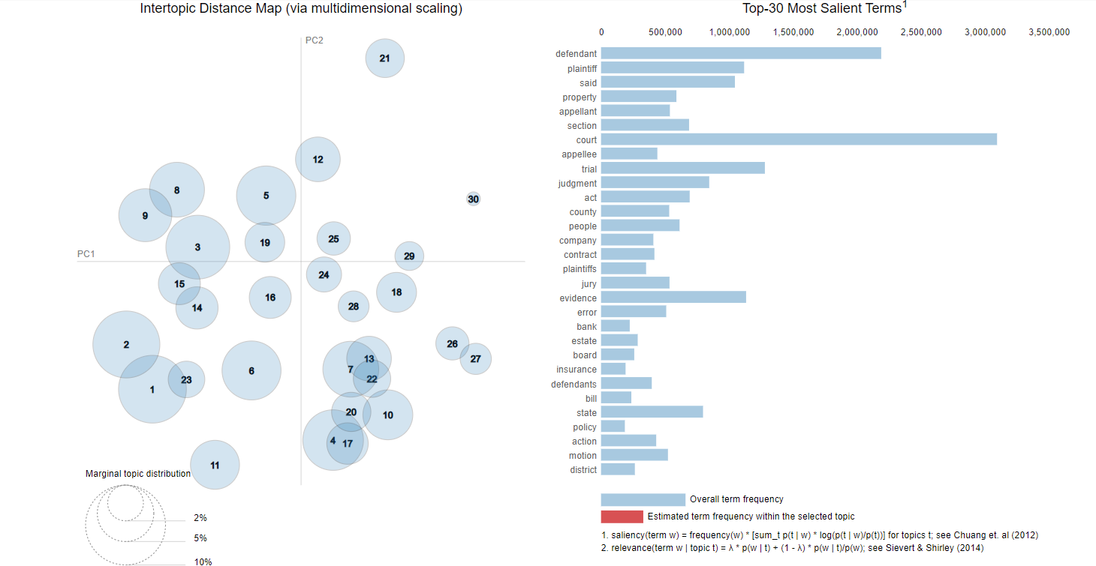
Topic model
From topic 21 we may see the word "appellant" is in absolute contrast with Topic 1 and 2 which contains the words "defendant" and "evidence" (which, by the way, are correlated);
The defendant, from Topic 9, is negatively correlated to everything that regard banks, as we can see from Topic26 and 27;
From Topic 1 and 2 we can see perhaps the most obvious thing: "evidence", "testimony" and "defendant“ are positively correlated; But less obvious is the, again positive, correlation between "evidence", "testimony","trial" and medical-related word (e.g., hospital, treatment, care, etc.) that can be seen from Topic 1-2 and 23

Slide 9
Conclusion
there exist some correlation between word that might imply the legal decision (like, for example, in the case of a trial for hospital-related words);
the appellant does not pair well with questions;
we may expect that a formal language is preferred;
the appellant should be careful about evidence. As matter of fact, from Court of Appeal, BC we see: "in general, you cannot introduce new or additional evidence at your appeal. You must rely on the evidence that you submitted in the previous proceedings.“ (https://www.courtofappealbc.ca/appellant-guidebook/3.5-introducing-new-evidence).
the defendant should pay attention about the financial word (e.g., banks)

